Slide 1











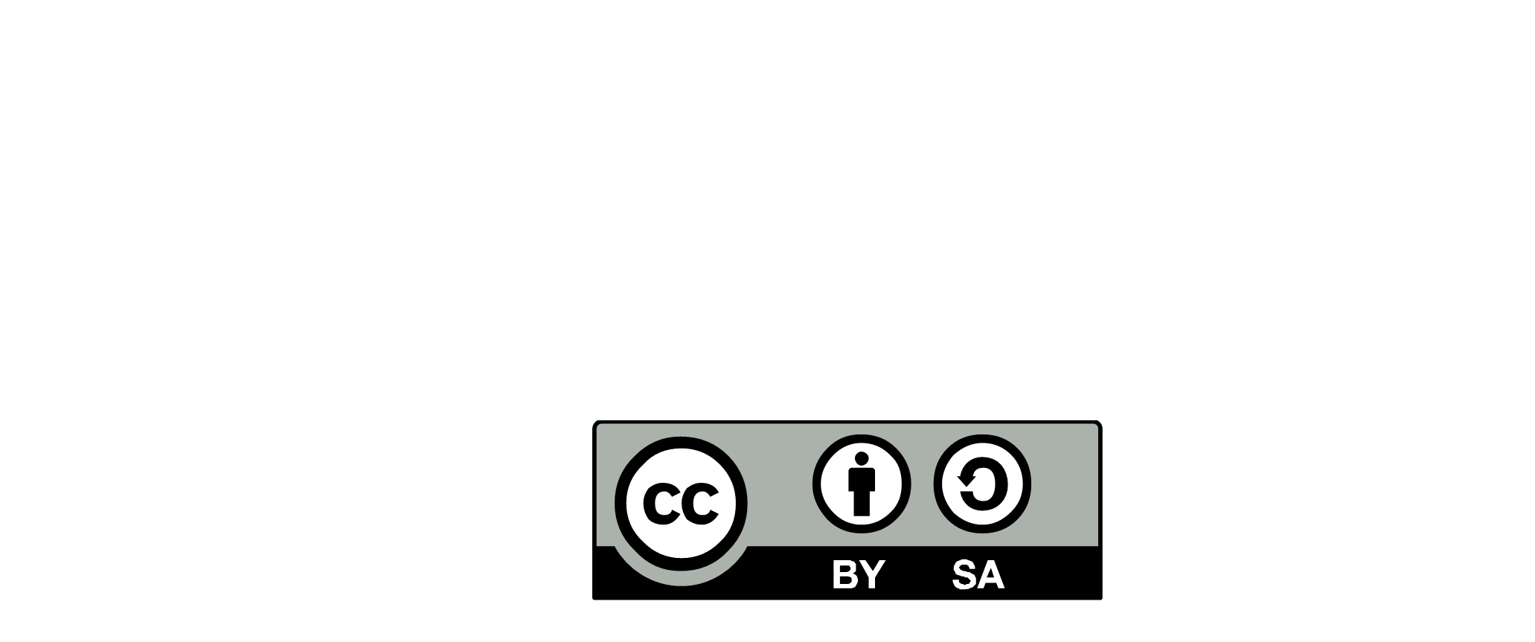

Architecture
Community
Enterprise
& Portfolio
BUSINESS CAPABILITIES
Develop capabilities
VALUE CHAIN
OPERATING MODEL
PROCESS IMPROVEMENTS
FUNCTIONAL ROADMAP
INNOVATION
IS PORTFOLIO
Rationalize & Transform
GLOBAL FUNCTIONAL DEBT
OBSOLENCE MANAGEMENT
DECOMMISSIONING
SYSTEM ENGINEERING
ARCHITECTURE STUDIES
VALUE HARVESTING
End-to-end integration
MUTUAL REQUIREMENTS
FUNCTIONAL CONTRACT
FUNCTIONAL DEPENDENCY MIGRATION STRATEGY
PRODUCT/COMPONENT CATALOG
IS KNOWLEDGE
REFERENCE ARCHITECTURE
Contribute to clarify
DIAGNOSIS
WHAT IF SCENARIO
IS PROJECTION & PLANNING
Maximize value
IS PORTFOLIO
PRODUCT VALUE PROPOSITION
KPI
Co-develop architecture capabilities
GREEN PATTERNS
PRINCIPLES
PROMOTE
PRODUCT
ARCHITECT
CONNECT THE DOTS
Explain and deploy
MARKETING ARCHITECTURE
PRODUCT SERVICES
SERVICE LEVEL
Global & local dialog
DECISION MAKER
TRADE OFF
End user value is our continuous obsession
BUSINESS
SPONSOR
Be green : Advocate for the next generation
PRODUCT
OWNER
END USER*
CONNECT THE DOT
Promote Reference Architecture
EXPLAIN, CONTEXTUALIZE
Local Coaching
Mentoring
END USER
PROBLEM SOLVING
PRODUCT LIFE CYCLE
Identify and resolve pain points
KNOW YOUR CUSTOMER
USER EXPERIENCE
PAIN POINT IDENTIFICATION
FUNCTIONAL STUDIES
Short, mid, long term
FROM IDEATION TO RETIREMENT
PRODUCT AS A SERVICE
FITNESS FUNCTION
SKILLS AND
COLLABORATION
Be a change agent
FUNCTIONAL ANALYST
EMPOWERMENT
EVERGREEN AGENT
DECISION MAKER
INNOVATION
PRODUCT ARCHITECTURE
Evolutionary Architecture
PRODUCT VISION
BUSINESS AND FUNCTIONNAL ARCHITECTURE
FUNCTIONAL CHOICES
RISK MANAGEMENT
Domain
Program
TEAM
LEADER
UX
TEAM
LEADER
TEAM
LEADER
DELIVERY
SQUAD(s)
UX
UX
DELIVERY
SQUAD(s)
DELIVERY
SQUAD(s)
SOLUTION IMPLEMENTATION
DEV.
TECH
LEAD
DEV.
TECH
LEAD
DEV.
TECH
LEAD
Functional integration
CATALOG KNOWLEDGE
GAP ANALYSIS
COMPONENTS REQUIREMENTS
CONFIGURATION
END USER*
- CLIENT
- BUSINESS
- EMPLOYEE
- PARTNER
PRODUCT ARCHITECT
-2020.2 -
DESIGNED BY :

